Slide 1
Lango for NFL Canada
All rights reserved
August, 2013

Slide 2
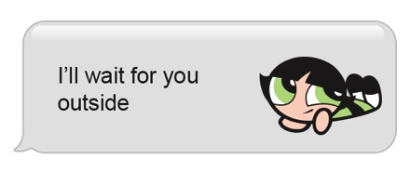
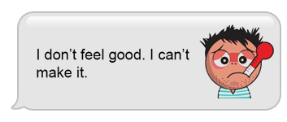


Lango - endless source of self-expression
Text with Image: Using Lango you can elaborate basic words and phrases with images that addictively depict emotion, expression, humor and personal touch.
Editorial illustration - DAILY Lango generates fresh daily content that turn what’s happening right now into unique messageble images.
All Sparks and Flair can be sent to a person or posted to social media

Slide 3
Lango app - major highlights
Employ two types of messages in one app:
Spark - a text with a unique or custom icon attached based on the essence of the message.
Flair - a poster-like image which allows you to add your own commentary in order to create your own meme and share on social networks.
Operate as newspaper editorial – new icons released daily based on relevant content
In-app store for virtual goods allows users to easily integrate premium content per their choice
Works cross platform, both on iPhone (data) and on Android (both SMS & data)

Slide 4
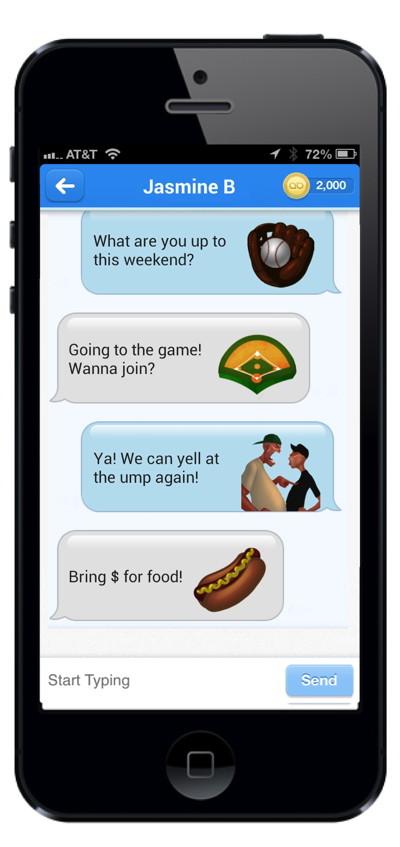
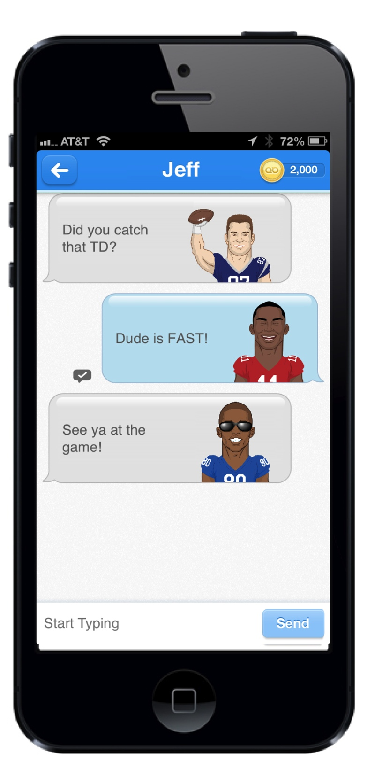
Spark – Text Bubble with Image

Slide 5
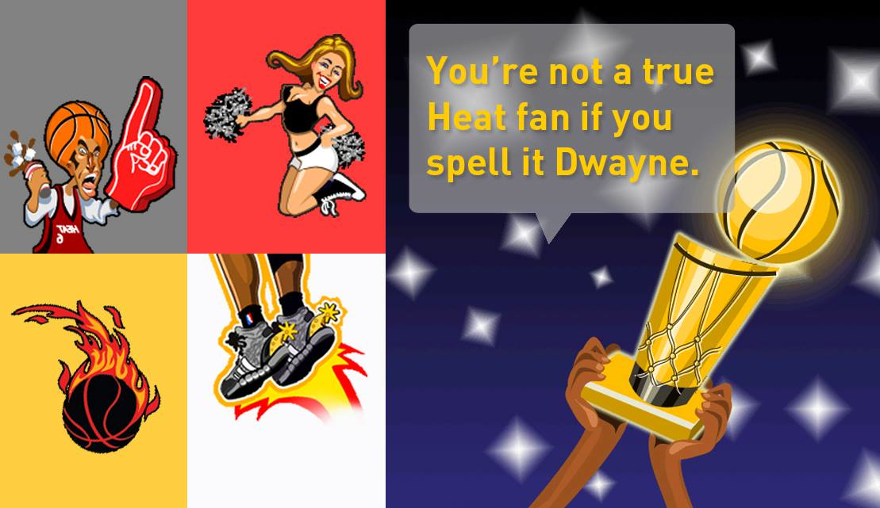
Flair – Create a customized message on your phone and publish to Facebook and Twitter
Step 1: Choose Background
Step 2: Type Text
Step 3: Post to Social Media

Slide 6
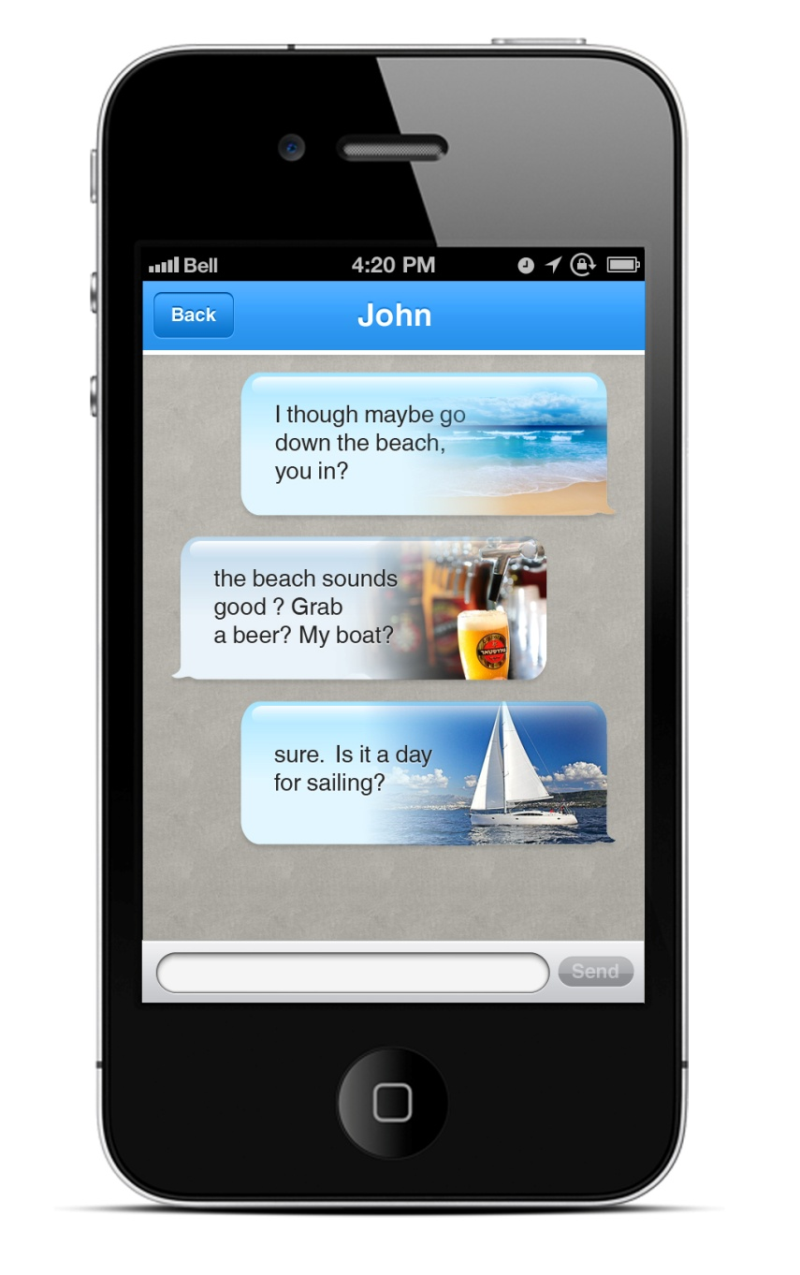
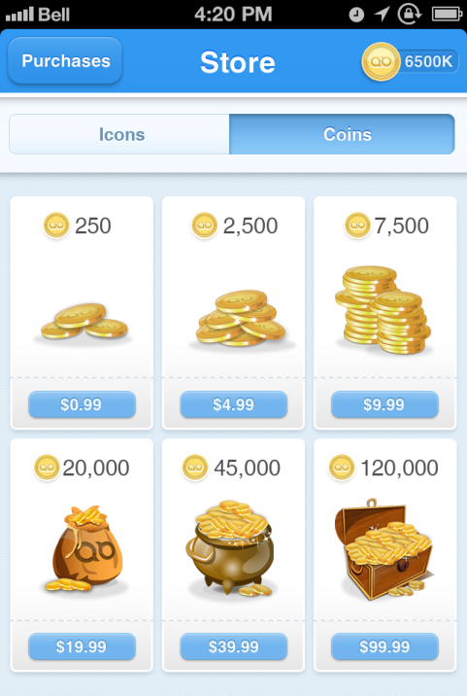
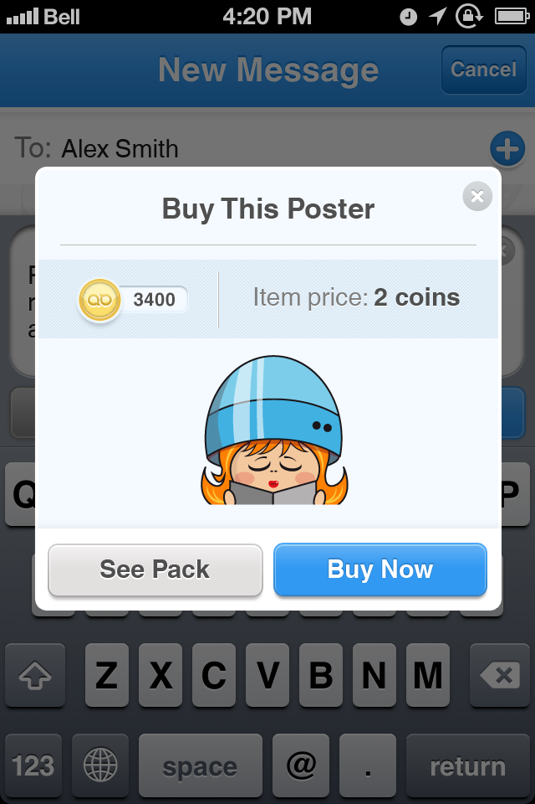
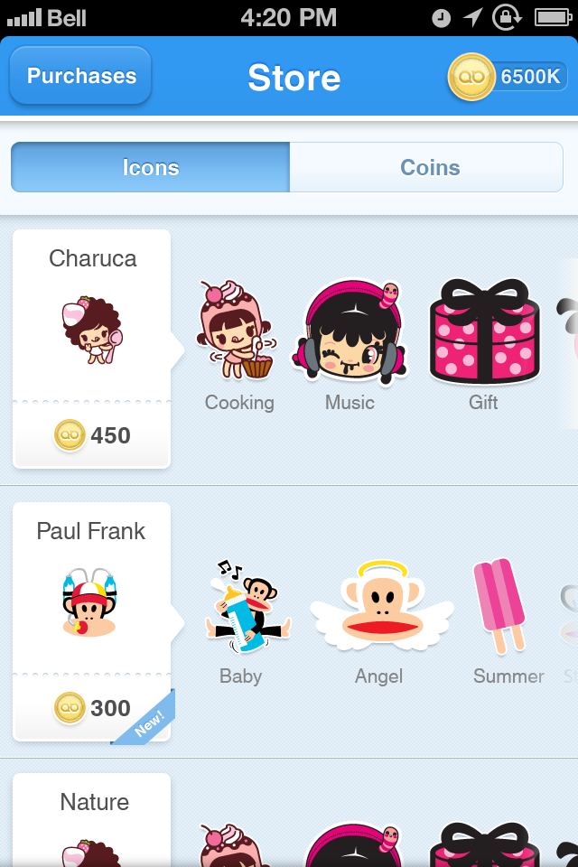
Lango in-app virtual goods store

Slide 7
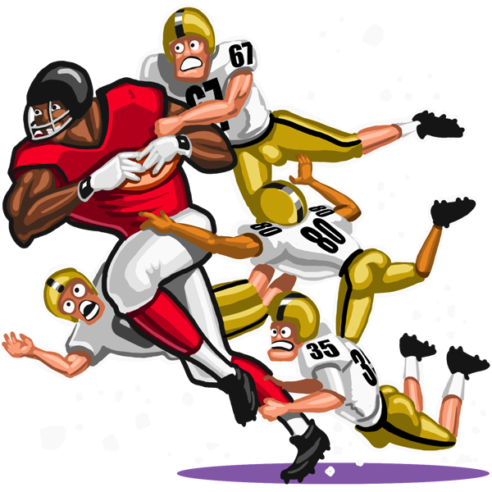


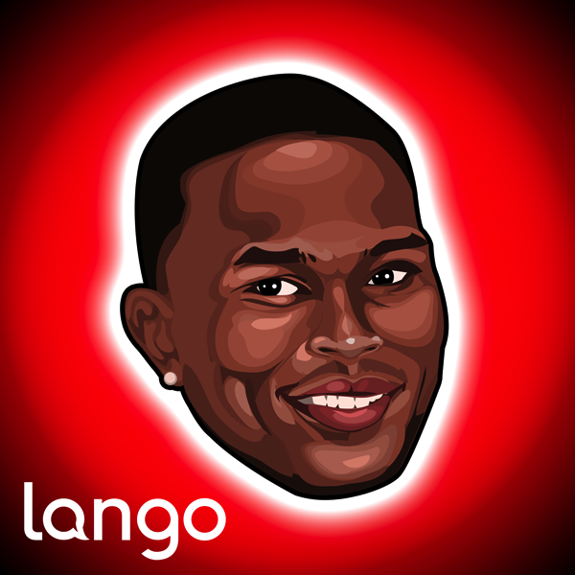
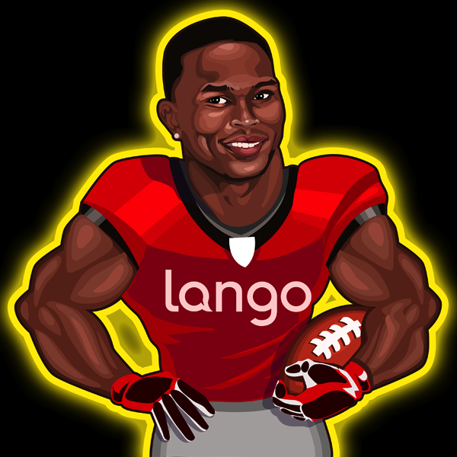

Slide 8


Thank you!

